Slide 1

Docker for Java developers
Dima Ionut Daniel

Slide 2
Contents
What is Docker?
History
Architecture
Features
Concepts
Core
Docker Files
Common Commands
Tools
Container Orchestration
Conclusions
Bibliography

Slide 3

What is Docker?
Docker is an open-source project that automates the deployment of applications inside software containers by providing an additional layer of abstraction and automation of OS virtualization.
Docker is a PaaS(platform as a service) that uses OS-level virtualization.
Docker uses resource isolation features of the Linux kernel to allow independent containers to run within a single Linux instance avoiding the overhead of starting virtual machines.
Docker implements a high-level API to provide lightweight containers that run processes in isolation.
It is built on top of facilities provided by Linux kernel(cgroups and namespaces) and it doesn't require or include a separate operating system.

Slide 4
History
Containers in general :
have their own process space
have own network interface
run processes as root inside the container
have their own disk space and can share with host too

Slide 5
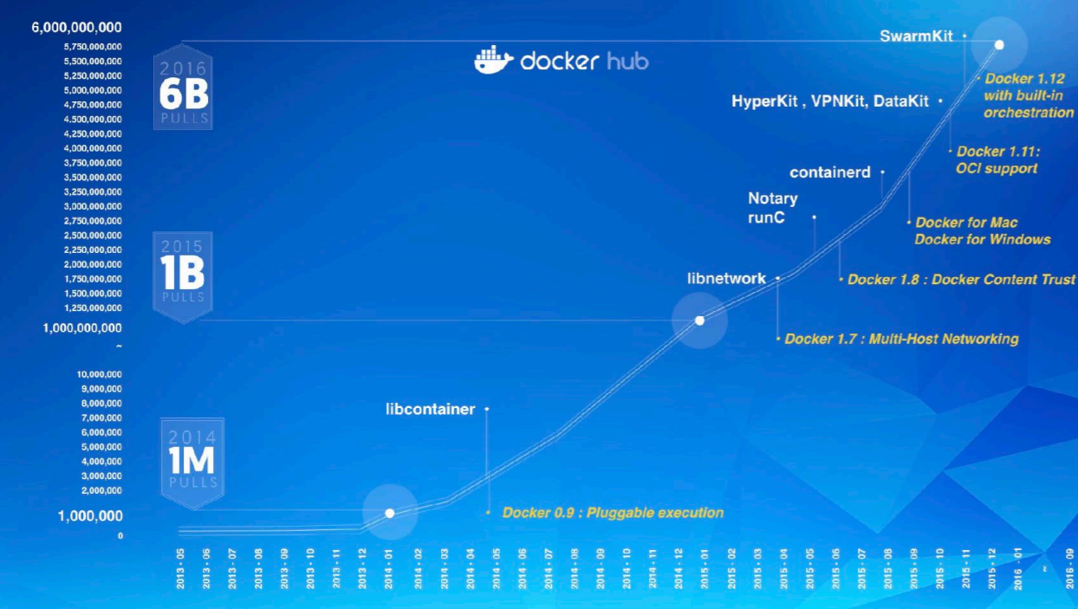
History

Slide 6
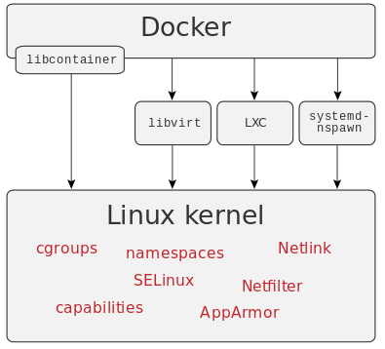
Architecture
Docker is a way of managing multiple containers on a single machine.
Fundamental support for containerization was included in the Linux 2.6.24 kernel to provide operating system-level virtualization and allow a single host to operate multiple isolated Linux instances, called Linux Containers (LXC).
LXC is based on Linux control groups (cgroups) where every control group can offer applications complete resource isolation (including processor, memory and I/O access).

Slide 7
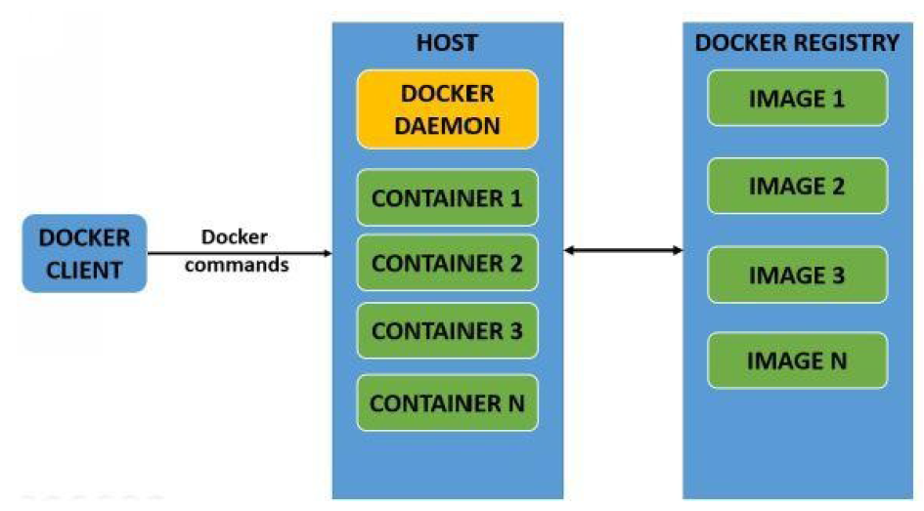
Architecture (cont.)
Docker has client/server architecture.
The Docker client instructs the Docker daemon for all the container specific tasks.
The communication between them is done by REST API.
Docker client and Docker daemon can be on the same host or different hosts.

Slide 8
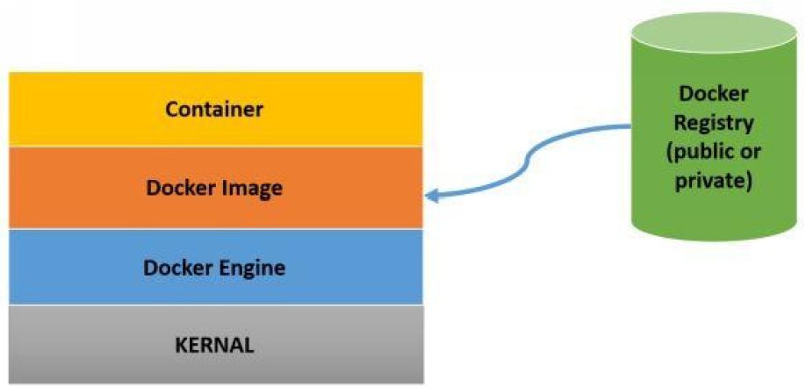
Architecture (cont.)
Docker daemon is responsible for all container operations.
Docker client can either be installed on the same host as Docker daemon or in a different host.
Docker has 3 internal components:
1. Docker image
2. Docker registry
3. Docker container

Slide 9
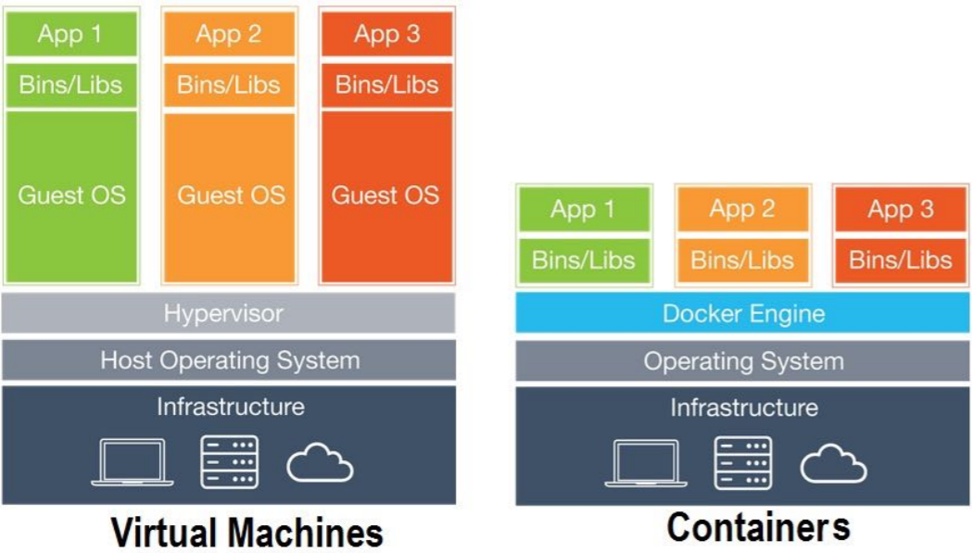
Architecture (cont.)
A container is not a VM

Slide 10
Architecture (cont.)
Docker image:
The Docker image is a template that consists of OS(Ubuntu,etc) and applications installed on it.
A Docker base image is the building block of a Docker container from where container is created.
Docker registry:
Docker registry is a repository for Docker images.
It can be public(Docker hub) or private.
The public Docker registry has a vast collection of official and user created images.
Docker container:
A container contains the execution environment for applications.
Each container has its own user space, network, security settings associated with it.

Slide 11
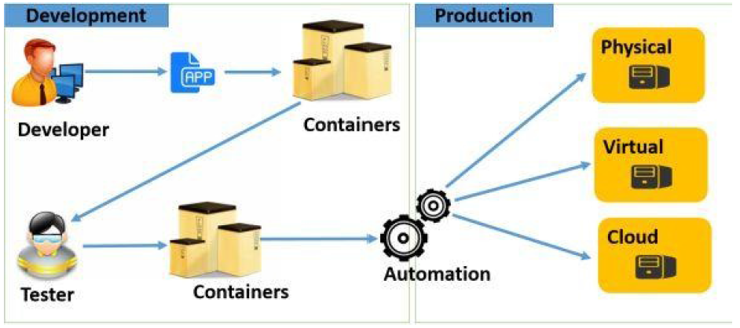
Features
Portable Deployments:
as containers are portable, the applications can be bundled into a single unit and can be deployed to various environments without making any changes to the container
Scale and deploy with ease:
Docker containers can virtually run on any Linux system.
Containers can be deployed on cloud environments, desktops, on premise datacenters, physical servers and so on.
Fast application delivery:
deploy the applications to production environments really fast.

Slide 12
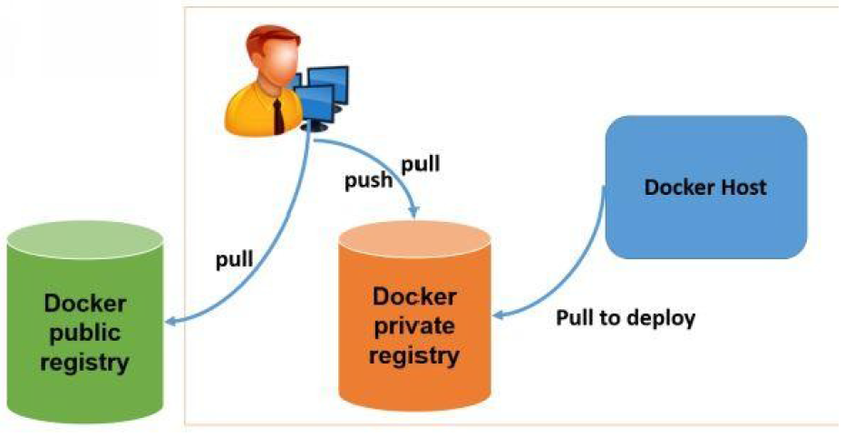
Features (cont.)
Images can be searched from Docker client and Docker hub web ui.

Slide 13
Concepts
Docker image – representation of a docker container
Docker Container – the standard runtime of Docker
Docker Engine – it manages Docker, CRUD operations with Docker Containers
Docker Daemon - listens for Docker API requests and manages Docker objects such as images, containers, networks and volumes
Docker Client is the primary way that many Docker users interact with Docker

Slide 14
Concepts (cont.)
A Docker registry stores Docker images. Docker Hub is a public registry that anyone can use, and Docker is configured to look for images on Docker Hub by default.
Docker objects:
images - read-only template with instructions for creating a Docker container.
containers - runnable instance of an image, CRUD operations using Docker API,CLI.
services - allow to scale containers across multiple Docker daemons, which all work together as a swarm with multiple managers and workers

Slide 15
Core
Docker platform can be used by developers and system administrators for developing and shipping applications to different environments.
A developer can install and configure an application in Docker container, pass it on to an ops person and he can deploy it on to any server running Docker.
A container is started from an image, which may be locally created, cached locally, or downloaded from a registry.
Docker Inc operates the Docker Hub public registry, which hosts official repositories for a variety of operating systems, middleware and databases.

Slide 16
Core (cont.)
There are two ways to create application packages for containers Manual and Dockerfile.
Manual builds
It starts by launching a container with a base operating system image.
Normal process for installation of an application on the operating system is performed and once the application is installed.
The container can be exported to a tar file or can be pushed to a registry like Docker Hub.
Dockerfile
The Dockerfile specifies the base image to start and then the other installation on top are defined as a series of commands that are run or files that are added to the container.
The Dockerfile also can specify other aspects of configuration of a container such as ports, default commands to be run on startup, etc.

Slide 17
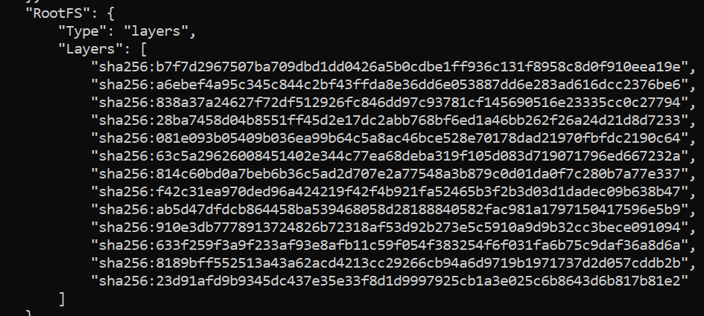
Core (cont.)
Docker image defines a Docker container and are immutable.
It's similar concept to a snapshot of a VM.
Images are built in layers; each layer is an immutable file.
Layers receive an ID, calculated via a SHA 256 hash of the layer contents. If the layer contents changes, then the SHA 256 hash changes also.
Eg: docker image inspect <container name>

Slide 18
Core (cont.)
Docker Hub is a repository for uploading and downloading Docker images.
The Docker command is associated with several arguments and flag.
The standard use of a Docker command is: docker [flags] [command] [arguments].
The -t flag assigns a terminal session for the container.
The -i assigns an interactive session for the container by getting the STDIN of the container.
The -d flag will run the container in the background.
docker run -i -t busybox /bin/sh --> will download busybox image and start a container with sh shell.
docker ps –a --> shows created containers.
docker run -i –t centos /bin/sh --> will download centos image and start the container with sh shell.
The docker command will list all the commands.

Slide 19
Core (cont.)
Docker containers in general :
have their own process space
have own network interface
run processes as root inside the container
have their own disk space and can share with host too

Slide 20
Core (cont.)
Docker images are the basic building blocks of a container.
All the images downloaded from the Docker hub reside in the Docker host.
In an image specified by the Docker run command isn't present in the Docker host by default, the Docker daemon will download the image from the Docker public registry.
Container is a writable layer on a top on an image.
We can list the Docker images by running "docker images" command.

Slide 21
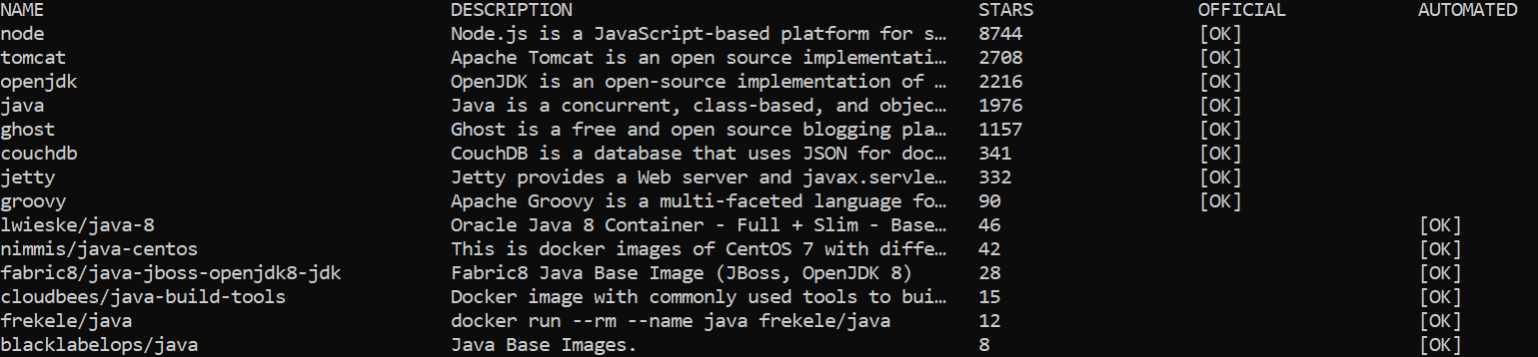
Core (cont.)
Docker host will not have any images by default.
All the images have the following information: REPOSITORY, TAG, IMAGE ID, CREATED, VIRTUAL SIZE.
Once the image is downloaded, we can create a container in seconds.
Images can be searched using Web Interface: https://hub.docker.com/ or using the command line: "Docker search [image name]".

Slide 22
Docker File
Dockerfile is a normal text file with instructions for configuring an image.
Instructions include tasks such as creating a directory, copying file from host to container, etc.
Every line in a Dockerfile starts with an instruction followed by a statement.
Every instruction creates a layer on the image when the image gets build from the Dockerfile.
Sample:
FROM ubuntu:14.04
MAINTAINER bibin wilson <bibin.w@hcl.com>
RUN apt-get update && apt-get install -y ruby ruby-dev
RUN gem install sinatra

Slide 23
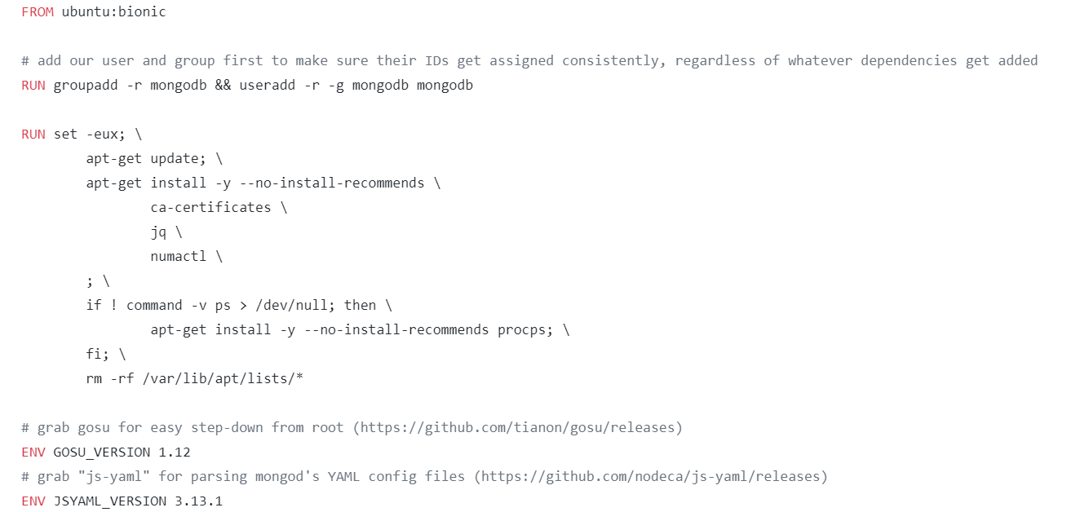
Docker File (cont.)
Every command that is run in the dockerfile creates an image layer.

Slide 24
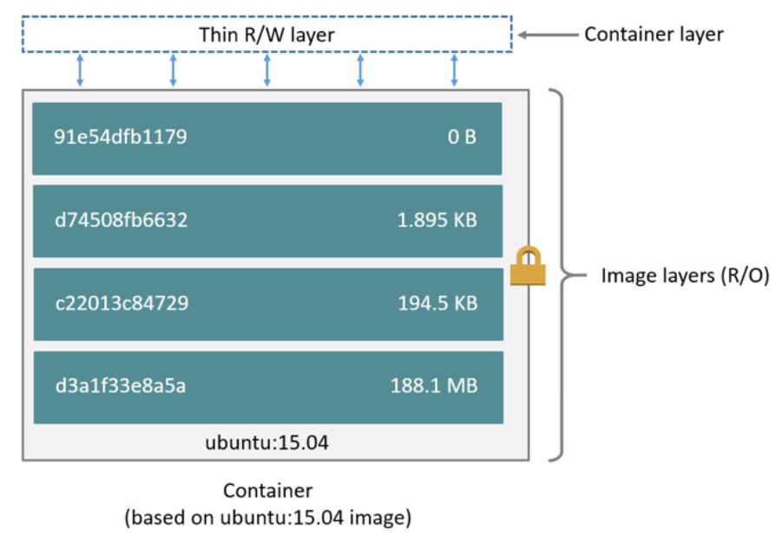
Docker File (cont.)
The layers are stacked on top of each other.
When we create a new container, you add a new writable layer on top of the underlying layers.
This layer is often called the "container layer".

Slide 25
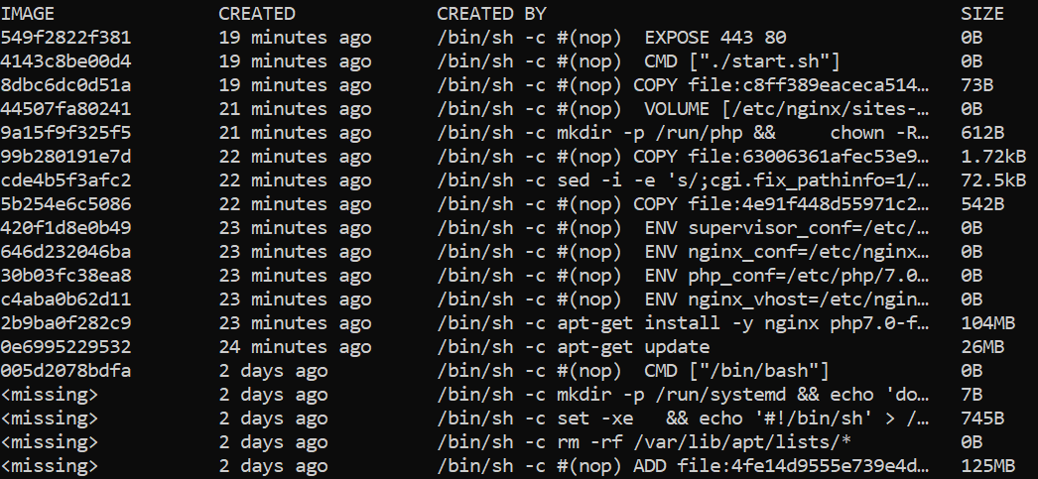
Docker File (cont.)
The "docker history <image hash>“ displays the layers of an image.

Slide 26
Docker File (cont.)
The "docker build" command builds and image from a Dockerfile and a context.
The build is run by the Docker daemon, not by the CLI.
To tag the image into multiple repositories after the build, we use -t parameters
eg: docker build -t shykes/myapp:1.0.2 -t shykes/myapp:latest .

Slide 27
Docker File (cont.)
Command | Description
FROM | Specified the base image for building the image
MAINTAINER | Optional, it contains the name of the maintainer of the image
RUN | Executes a command during the build process of the docker image
ADD | Copies a file from the host machine to the new docker image. URL can also be used to download the files to the destination directory
ENV | Defines an environment variable
CMD | Used for executing commands when the container is built from the docker image
ENTRYPOINT | Defines the default command that will be executed when the container is running

Slide 28
Docker File (cont.)
Command | Description
WORKDIR | Directive for CMD command to be executed
USER | Set the user or UID for the container created with the image
VOLUME | Enable access/linked directory between the container and the host machine

Slide 29
Common Commands
Command | Description
docker images -a | lists all docker images
docker ps | list all running docker containers
docker ps -a | list all docker containers
docker start <container name> | start a docker container
docker stop <container name> | stops a docker container
docker kill $(docker ps –q) | kills all running docker containers
docker logs <container name> | View the logs of a running docker container
docker rm <container name> | remove a docker container
docker rm $(docker ps -a -q) | deletes all docker containers

Slide 30
Common Commands (cont.)
Command | Description
docker rmi <image name> | remove a docker image
docker rmi $(docker images -q) | deletes all docker images
docker exec –it <container name> bash | will give a bash shell in the container
docker-compose build | checks for docker-compose.yml to build containers
docker-compose up -d | starts a group of containers
docker-compose logs -f | Follows the logs of running docker containers with Docker Compose

Slide 31
Common Commands (cont.)
Command | Description
docker run <image> | runs a docker image
docker built –t <tag name> | build a docker image
docker run –d <image> | runs docker image in background
docker –p <host port>:<container port> | maps a host port to a container port
docker –e MY_VAR=val <container name> | specifies an ENV variable for a docker container
docker exec –it <container name> bash | shell into a running docker container
docker run -v <host path>:<container path> <image name> | share storage on a host system with a docker container

Slide 32
Common Commands (cont.)
Command | Description
docker swarm init | enables the first node of a docker swarm
docker service ls | list running services
docker swarm join –token <token> --listen-addr <ip:port> | adds a node to a swarm cluster
docker swarm join-token | retrieve the join token
docker node ls | list nodes in a cluster
docker node rm <node name> | removes a node from a docker swarm
docker service rm <node name> | removes a service

Slide 33
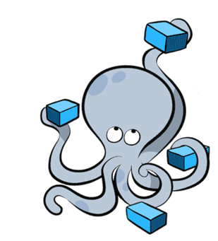
Tools
Docker Compose is a tool for defining and running multi container Docker applications.
It uses YAML files to configure application services and performs the creation and start-up process of all the container with a single command.
The docker-compose.yml is used to define the application's services and includes various configuration options.

Slide 34
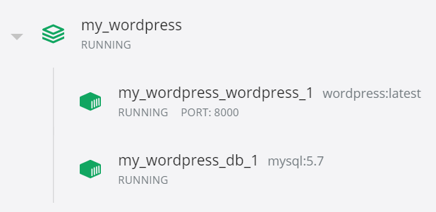
Tools (cont.)
To build the project based on the docker-compose.yml we run the command: "docker-compose up -d“
The services that were started can be checked in Docker Dashboard
To shutdown the containers we run the command: “docker-compose down”

Slide 35
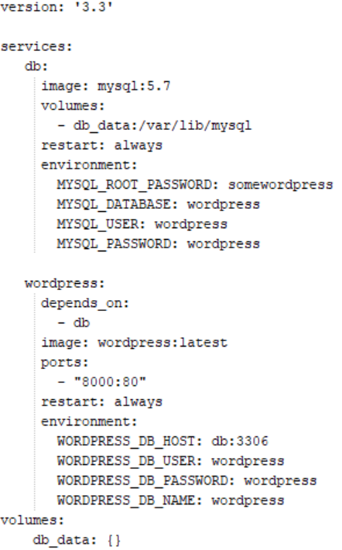
Tools (cont.)

Slide 36
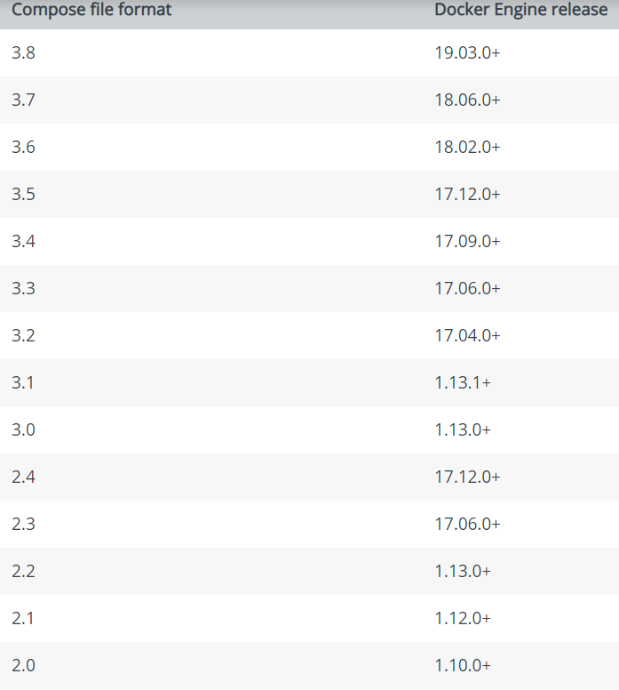
Tools (cont.)
There are several versions of the Compose file format: 1, 2, 2.x and 3.x.

Slide 37
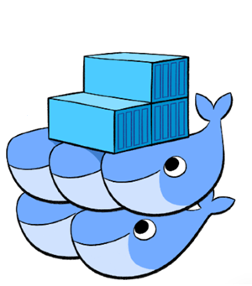
Tools (cont.)
Docker Swarm provides native clustering functionality for Docker containers which turns a group of Docker engines into a single virtual Docker engine.
The docker swarm CLI utility allows users to run Swarm containers, create discovery tokens, list nodes in the cluster, etc.
The docker node CLI allows to run commands to manage nodes in a swarm.

Slide 38
Tools (cont.)
With containerized deployments, contains are distributed across many nodes. Containers need to be deployed and managed.
Docker Swarm mode is not enabled by default, it can be enabled by the command: docker swarm init.
Once enabled other options are available like:
docker swarm
docker node
docker service
docker stack
docker secret

Slide 39
Tools (cont.)
Docker swarm init command initializes PKI (Private Key Infrastructure):
creates Root Signing Certificated for the Swarm
Cert Issued for first Manager Node
Created Jon Tokens
Creates Raft Consensus Databases
raft is a protocol so sync multiple nodes
stores Root Signing Certificate
Configuration Data
Secrets
Encrypted by default on disk

Slide 40
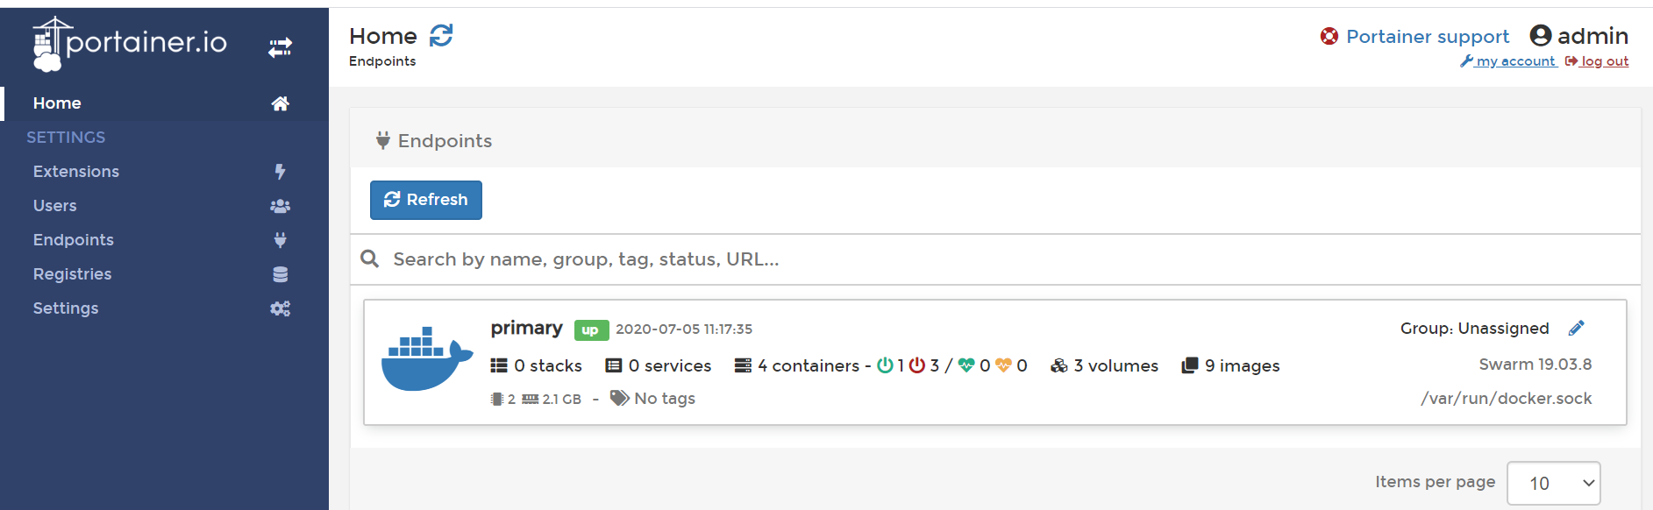
Tools (cont.)
Portainer
is used to easy build, manage and maintain Docker environments.
is easy to use software that provides an intuitive interface for both software developers and IT operations.

Slide 41
Tools (cont.)
It can be started with bellow command:
docker run -d -p 9000:9000 -p 8000:8000 --name portainer --restart always -v /var/run/docker.sock:/var/run/docker.sock -v portainer_data:/data portainer/portainer -H unix:///var/run/docker.sock

Slide 42
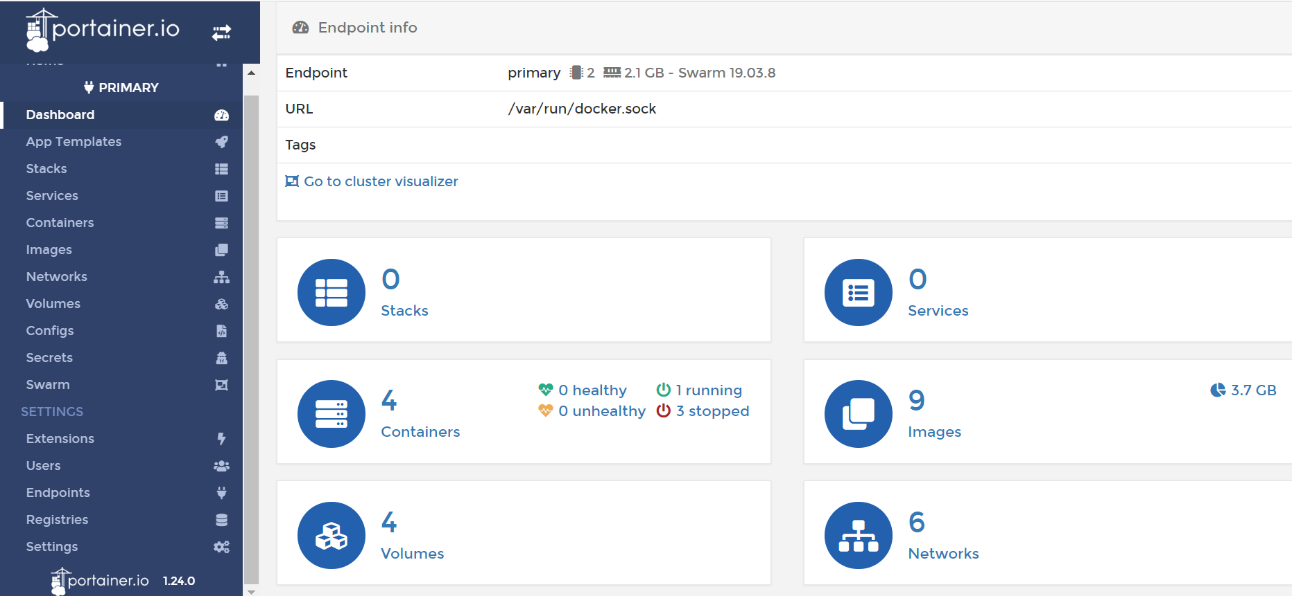
Tools (cont.)

Slide 43
Container Orchestration
Container orchestration is the automated configuration, coordination and management of software.
This is often discussed in the context of service-oriented architecture, virtualization, provisioning.
Solutions:
Docker Swarm Mode
Kubernetes
Openshift
Openshift Origin
Apache Mesos
Mesophere

Slide 44
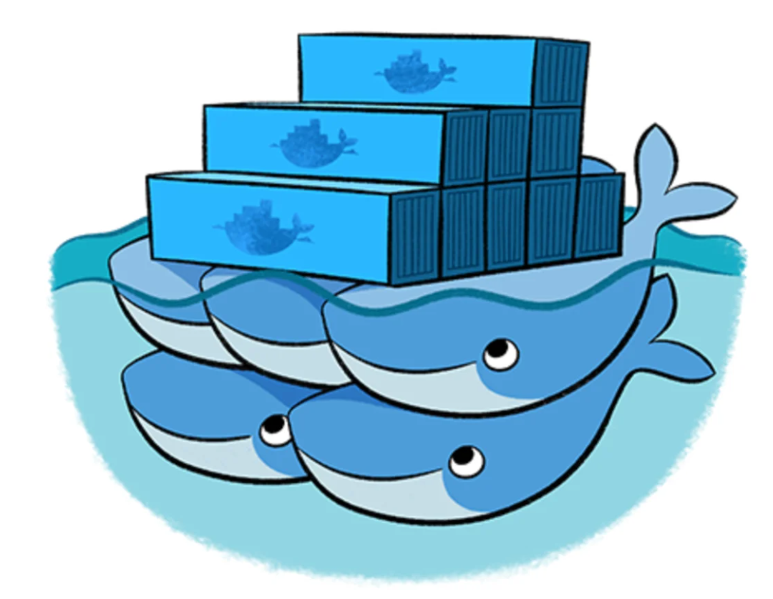
Container Orchestration (cont.)
Docker Swarm mode:
Managed by Docker Engines
It's a mature product
It's open source
Less and easy configuration

Slide 45
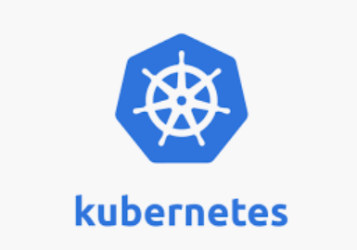
Container Orchestration (cont.)
Kubernetes:
Released by Google to manage millions of containers
It's open source
It's mature and feature rich
Complex and not so easy configuration

Slide 46

Container Orchestration (cont.)
Openshift:
Wrapped around Kubernetes
Licensed by RedHat, popular with large enterprises

Slide 47

Container Orchestration (cont.)
Openshift Origin:
Open Source version of Openshift
Community supported

Slide 48

Container Orchestration (cont.)
Apache Mesos:
Open source platform
Developed by Apache
Abstract the datacenter

Slide 49

Container Orchestration (cont.)
Mesophere:
Commercial version of Apache Mesos
Popular option with large enterprises

Slide 50

Bibliography
http://en.wikipedia.org/wiki/Docker_%28software%29
Docker Hands on Deploy Administer Docker Platform
Docker for Java Developers – Udemy
https://docs.docker.com/compose/compose-file

